Slide 1
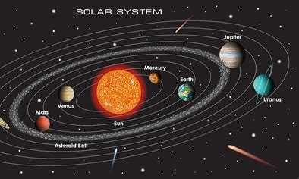
The Solar System – Page 1
Hello space explorers! Are you ready for a fun fact? Everything zipping, zooming, or floating around in the never-ending, super-sized universe is called a celestial body. "Celestial" is a fancy word that means "heavenly". So, these are our heavenly buddies! Celestial bodies can be planets, moons, asteroids, comets, or stars. Imagine the Sun - it's a star and a celestial body. And our lovely home, Earth? Yep, it's a celestial body too. All these different things, whether big or small, if they're in space, they're called celestial bodies! Amazing, isn't it?
What does “celestial” mean? ___________________________________________________________________
What is a celestial body? ___________________________________________________________________
Can you name some examples of celestial bodies? ___________________________________________________________________ ___________________________________________________________________
Time to zoom out and look at the big picture: our solar system. It's like a giant cosmic playground filled with all kinds of celestial bodies. Imagine if the Sun wore a big shiny badge saying "Boss" because it's the biggest one around. But here's a funny twist: in space, it's not about size, it's all about gravity! And boy, the Sun has bucket loads of it. All planets, including our lovely Earth, dance around the Sun because of its gravity. Sounds like a cool cosmic dance party, right?
What is our solar system full of? ___________________________________________________________________
Why do planets dance around the sun? ___________________________________________________________________
What force makes the planets do this dance? ___________________________________________________________________

Slide 2
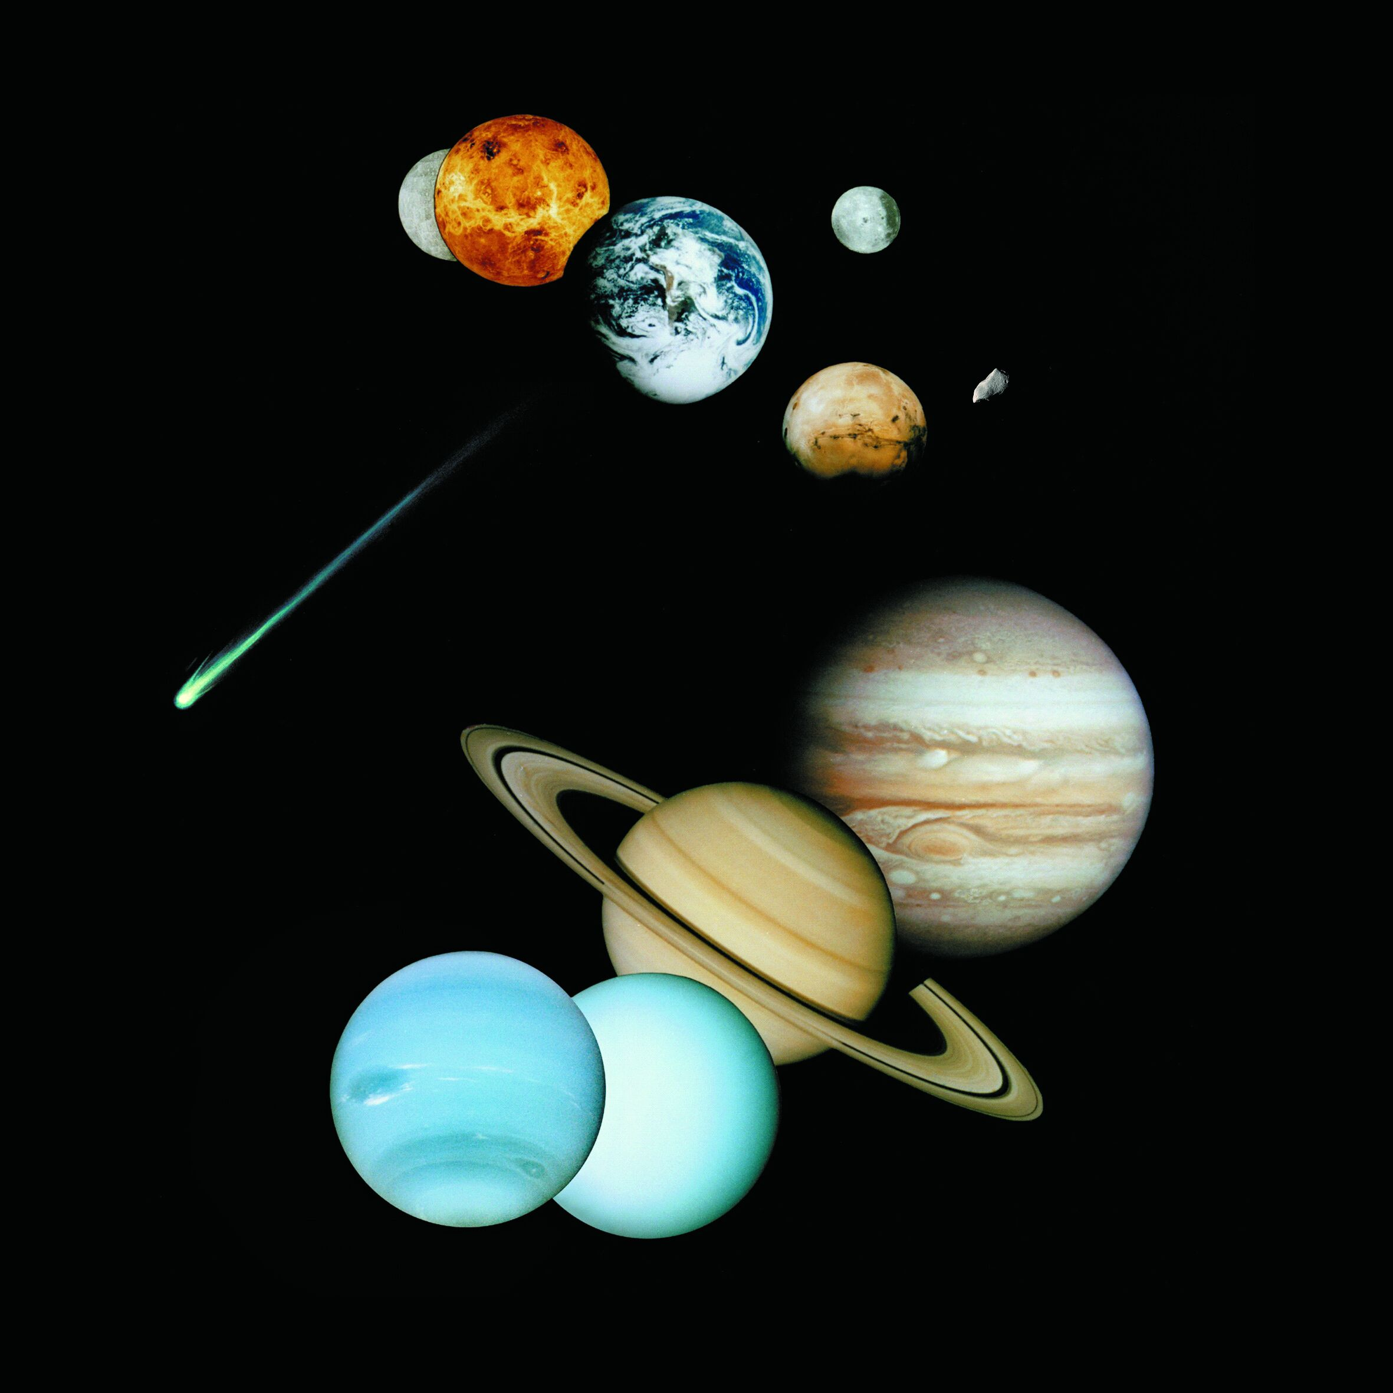
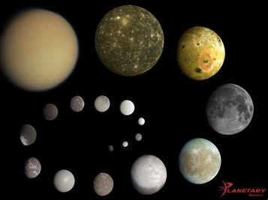
The Solar System – Page 2
Hop aboard our imaginary spaceship, because next, we're exploring planets! Planets are big, round celestial bodies that orbit around the Sun. In our solar system, we've got a family of 8 planets. Mercury is the closest to the Sun, then comes Venus, followed by Earth (hey, that's us!), Mars, Jupiter, Saturn, Uranus, and finally, Neptune. They all have their own quirky features like rings or stormy spots. No cotton candy clouds though. Bummer, right?
What are planets? __________________________________________________________________
How many planets are there in our family photo of the solar system? __________________________________________________________________
Why don’t planets have cotton candy clouds? __________________________________________________________________
Let's give a big shout-out to our next celestial buddies: Moons! Moons are like the little sidekicks that zoom around a planet. Our Earth has one trusty moon, the one that lights up our night sky. But some planets have a crazy amount of moons! Take Jupiter, for example. It has more than 60 moons! Can you even imagine a night sky with 60 moons? It'd be like the biggest, brightest disco party ever!
What is a moon? __________________________________________________________________
Can you name a planet with more than 60 moons? __________________________________________________________________
Just how many moons does Jupiter have? __________________________________________________________________

